Slide 1


HackerMakers – Hackathon PREDICTIVE ALGORITHM
POSITIVE COVID CASES IN USA

Slide 2
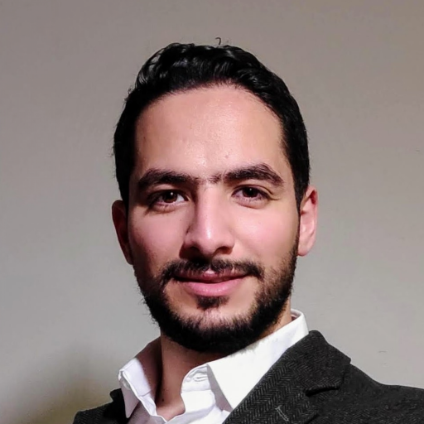


Team Members
Mentor
Amine Hadj Youcef (Phd)
Team Members
Deepak Kumar
Meghana Kankanala

Slide 3
TABLE OF CONTENTS
PROBLEM STATEMENT
VISUALIZATION
MODELLING
INSIGHTS AND PREDICTIONS
CONCLUSION

Slide 4

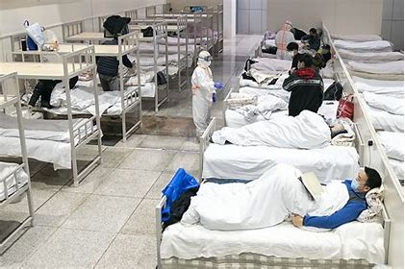
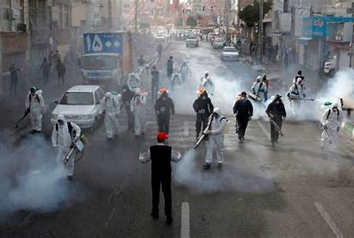
PROBLEM STATEMENT
A deep analysis into the drivers of the COVID-19 infection rate In the United Sates of America.

Slide 5
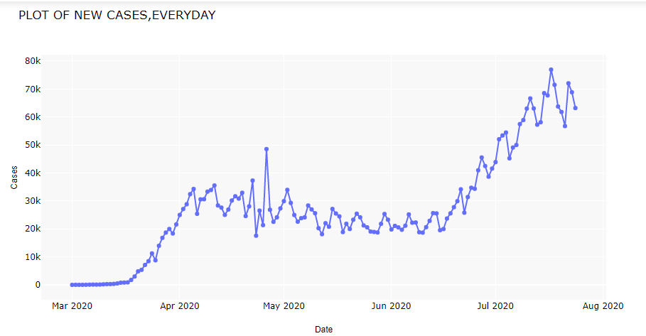
Problem Statement

Slide 6

Proposed Solution
Time series Prediction Machine Learning Models
Arima model
Arimax model
Prophet model

Slide 7

Web Application
Framework Used for Dashboard
Stream Lit
Scikit-Learn
Python
Pandas
Pyplot

Slide 8

.

